Slide 1
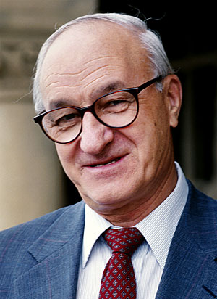
Albert Bandura’s Observational Learning Theory and Imitation

Slide 2
Bandura’s Biography
Born December 4, 1925 in Mundare which is a small town in northern Alberta, Canada
Received his bachelor degree in psychology at University of British Columbia.
Continued his schooling at University of Iowa and received his PHD in 1952.
It was at the University of Iowa where he became familiar with behaviorist tradition and learning theory.
In 1953, he wrote his first book along side of Richard Walters called Adolescent Aggression.
He was the President of American Psychological Association
In 1980 he received the APA award for distinguished scientific contributions.
He presently works at Stanford University

Slide 3
Observational Learning Theory
Bandura claimed that “in social situations, people often learn much more rapidly simply by observing the behaviors of others”
Bandura found that there are four components of observational learning:
  Attentional Processes
  Retention Processes
  Motor Reproduction Processes
  Reinforcement and Motivational Processes

Slide 4
Attentional Processes
One cannot imitate a model without paying attention to the model.
A model is often attractive because of the qualities he or she posses. These qualities such as prestige, power, and success gain the attention of the observer and begin the process of observational learning.

Slide 5
Retention Processes
Retention process is the way one remembers the model’s actions so he can imitate them.
Bandura explains, “In order to reproduce social behavior when the model is no longer present to serve as a guide, the response patterns must be represented in memory in symbolic form.
Example: mentally rehearsing the actions or practicing the actions will help one remember what he learned.

Slide 6
Motor Reproduction Processes
This is when a person uses the proper motor skills to accurately reproduce their model.
A five year old can observe his parent operate a car, but this does not mean he has the ability to correctly drive an automobile

Slide 7
Reinforcement and Motivational Processes
This process refers to the idea that a child will be more likely to imitate a behavior if he is likely to gain a reward
“When positive incentives are introduced, observational learning that previously remained unexpressed is likely to emerge in action.”

Slide 8
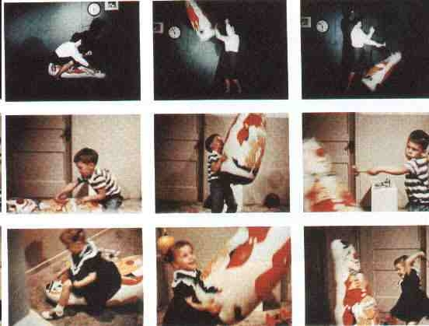
Bobo Doll Experiment

Slide 9
Models
Children are prone to imitate models that are more intelligent, skillful, and knowledgeable than themselves and others around them.
Children have a broad range of influences- parents, teachers, peers, and older siblings.
When a child has the choice, he is likely to select models with similar attributes and ignore those that have little in common with.
There are two types of models:
        Symbolic
        Exemplary

Slide 10
Symbolic Models
Models presented through oral or written instructions, pictorially, or through a combination of verbal and pictorial devices.
The media is a good example of pictorially presented models.
    television
    movies
    radio

Slide 11
Exemplary models
Can be pictorial models or represented through verbal descriptions.
A child is given an example whether it be a superhero, next door neighbor, or a friend and are told that these models actions are good and should be imitated, or in some cases, bad and should be avoided.

Slide 12
Three Effects of the Observation of Models
1. Observer may acquire new responses that were not in his repertory.
2. If model’s actions already exist in observer’s repertory, observation may strengthen or weaken inhibitory responses.
3. Sometimes observation of models draws out already known responses in observer

Slide 13
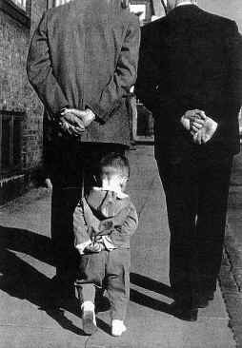
Imitation
Imitation is the actual performance of behavior that has been observed.

